Slide 1

HUMAN-CENTERED INDUSTRIAL SYSTEMS
Predictive Maintenance
Through Empathy Mapping
Designing alerts, evidence, and actions around the real decisions of factory maintenance teams.
01

Slide 2
Why Predictive Maintenance Needs Empathy
02
A technically correct alert can still fail in practice.
MACHINE SIGNALS
Technology succeeds when it fits real work: shifting priorities, incomplete evidence, production pressure, safety constraints, and the technician’s need to act with confidence.
HUMAN JUDGMENT

Slide 3
What Is Empathy Mapping?
03
A shared view of what a user expresses, considers, does, and experiences—then synthesized into needs and design insights.
SAY
What is voiced
THINK
What stays internal
DO
What is observable
FEEL
What work evokes
NEEDS
What must be enabled
INSIGHTS
What opportunity emerges

Slide 4
The Challenge We Are Exploring
04
How might we detect failure early—without overwhelming the people responsible for responding?
TOO LITTLE SIGNAL
Late intervention, avoidable damage, unplanned downtime
TOO MUCH NOISE
False positives, alert fatigue, delayed or ignored response
TRUSTED
PRIORITY

Slide 5

Meet the Primary Persona
05
Maya Chen
Senior Maintenance Technician
Maya keeps a high-throughput plant running across rotating shifts. She balances planned work, urgent calls, safety checks, spare-part limits, and constant coordination with operations.
CORE GOAL
Prevent downtime without wasting attention.

Slide 6

Context: A Day on the Plant Floor
06
Maya’s attention is continuously reprioritized. Planned inspections compete with line stoppages, radio calls, permits, parts searches, handovers, and documentation.
06:30 Shift handover
08:10 Routine rounds
10:25 Urgent line call
13:40 Verify sensor alert
15:20 Close work order

Slide 7
SAY: What Users Say
07
“Tell me which asset needs attention first.”
“Show me why the risk changed.”
“I need enough evidence to justify stopping the line.”

Slide 8
THINK: What Users Think
08
Is this a real failure pattern—or another spike?
What changed since the last inspection?
Will operations support the intervention now?

Slide 9
DO: What Users Do
09
Cross-checks vibration, temperature, and sound
Calls the operator for recent context
Uses spreadsheets, notes, and memory to verify

Slide 10
FEEL: What Users Feel
10
Responsible for consequences beyond direct control
Skeptical after repeated false alarms
Relieved when evidence and next steps are clear

Slide 11
Pain Points Across the Workflow
11
Detect
Interpret
Prioritize
Coordinate
Act
1
2
3
4
5
Fragmented data
Weak evidence
Unclear urgency
Response delays
Poor feedback loop

Slide 12
What Users Need
12
1
One trusted view of asset health
2
Priority tied to operational risk
3
Evidence that supports verification
4
A clear next action and owner
5
Feedback that improves future alerts

Slide 13
INSIGHTS: What We Learned
13
Trust grows from explainable evidence—not prediction scores alone.
Technicians already verify; good design shortens and strengthens that loop.
Urgency is contextual: asset risk must be connected to production impact.
Every resolved alert is a learning opportunity for both people and models.

Slide 14
From Empathy to Design Criteria
14
Relevant
Rank by operational consequence
Top risk understood in < 10 sec
Explainable
Expose signal, trend, and context
Evidence available in one view
Actionable
Name next step, owner, and timing
No dead-end alerts
Adaptive
Capture resolution feedback
Alert quality improves over time

Slide 15
Opportunity Areas
15
1
2
3
4
Risk-based
alert triage
Evidence-led
verification
Workflow-aware
coordination
Closed-loop
learning

Slide 16
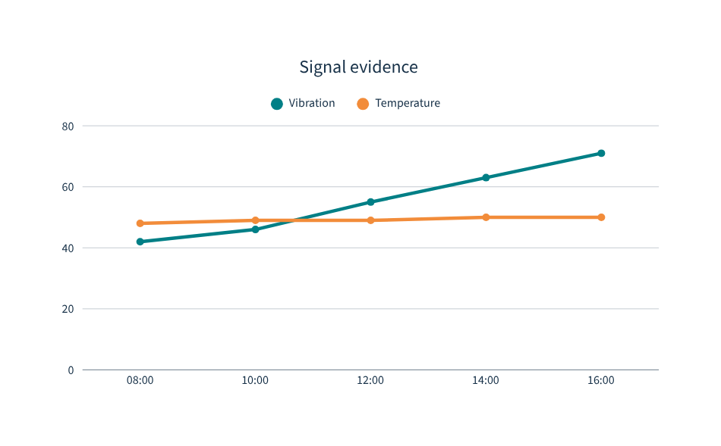
A Better Predictive-Maintenance Experience
16
PUMP P-204
Health risk: HIGH
NOW
Evidence
Vibration trend +18% · Temperature stable
Pattern matches bearing wear
NEXT ACTION
Inspect drive-end bearing within 4 hours

Slide 17
Example User Journey
17
1
2
3
4
5
Detect
Anomaly appears
Triage
Risk is ranked
Verify
Evidence checked
Coordinate
Window agreed
Resolve
Action recorded

Slide 18
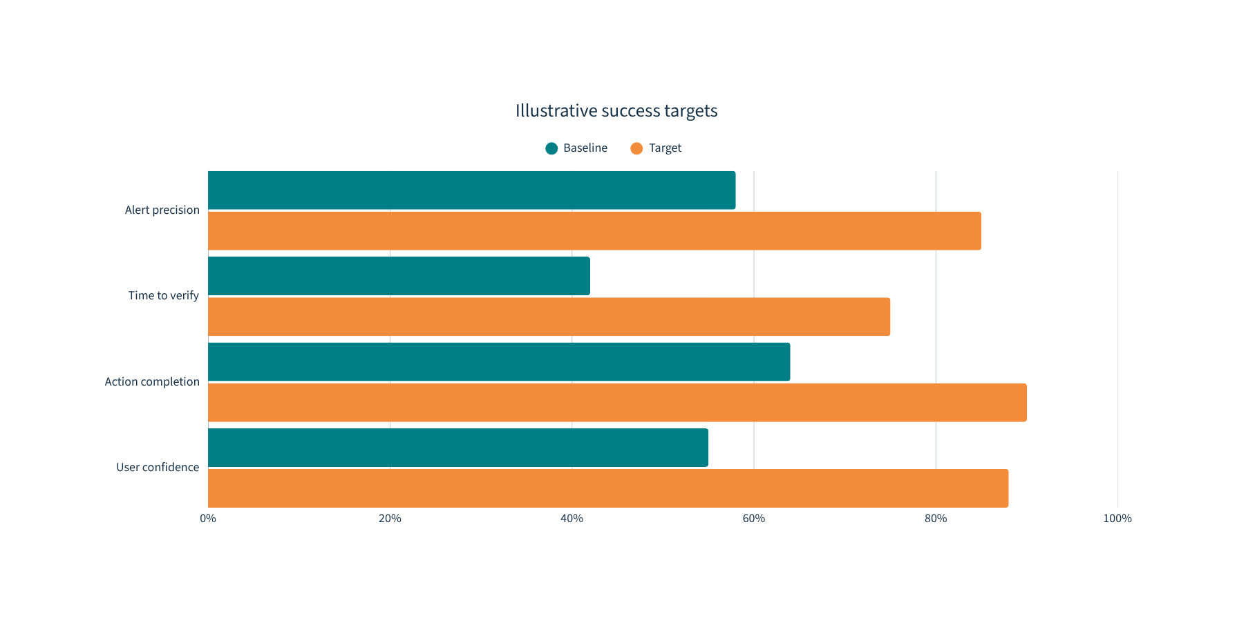
How We Could Measure Success
18
Balance operational outcomes with the quality of the human decision experience.

Slide 19
Complete Empathy Map
19
SAY
THINK
Priority first · Show why · Support the stop decision
Is it real? · What changed? · Will operations act?
DO
FEEL
Cross-check signals · Ask operators · Use workarounds
Responsible · Skeptical · Relieved by clarity
NEEDS Trusted view · Contextual priority · Evidence · Clear action
INSIGHTS Explain trust · Connect risk · Shorten verification · Learn

Slide 20
THE CENTRAL TAKEAWAY
Design for people,
not just machines.
Start with real maintenance work. Make risk explainable. Turn evidence into a clear next action. Capture outcomes so the system—and the team—keeps learning.
NEXT: Observe · Co-design · Prototype · Measure
20

